Slide 1
JSP

Slide 2
Java Server Pages
JSP technology allows you to easily create Web content that has both static and dynamic components.
JSP is Java in HTML.

Slide 3
JSP Contains
Static HTML/XML components.
Special JSP tags
code written in the Java programming language called "scriptlets."

Slide 4
JSP Advantages
Separation of static from dynamic content: With servlets, UI changes typically result in the recompilation of the servlet.
However, with JSP, the logic to generate the dynamic content is kept separate from the static presentation templates by encapsulating it within external JavaBeans components.
These are then created and used by the JSP page using special tags and scriptlets. When a page designer makes any changes to the presentation template, the JSP page is automatically recompiled and reloaded into the web server by the JSP engine.

Slide 5
JSP Advantages
Dynamic content can be served in a variety of formats: JSP can service a diverse clientele ranging from conventional browsers using HTML/DHTML, to handheld wireless devices like mobile phones and PDAs using WML, to other B2B applications using XML
Completely leverages the Servlet API: If you are a servlet developer, You are at a distinct advantage because JSP is nothing but a high-level abstraction of servlets

Slide 6
JSP Translation
JSP pages are subject to a translation phase and a request processing phase.
The translation phase is carried out only once, unless the JSP page changes.
The translation phase is typically carried out by the JSP engine itself, when it receives an incoming request for the JSP page for the first time.
JSP pages can be precompiled into class files.

Slide 7
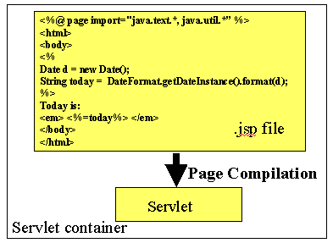

Slide 8
The JSP page implementation class file extends HttpJspBase, which in turn implements the Servlet interface.
Although _jspService() cannot be overridden,
The developer can describe initialization and destroy events by providing implementations for the jspInit() and jspDestroy() methods within their JSP pages.

Slide 9
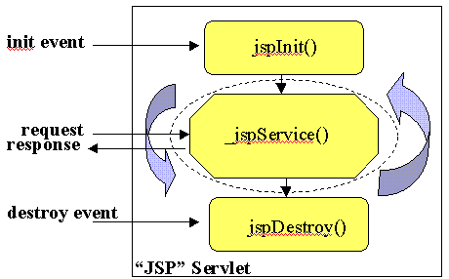

Slide 10
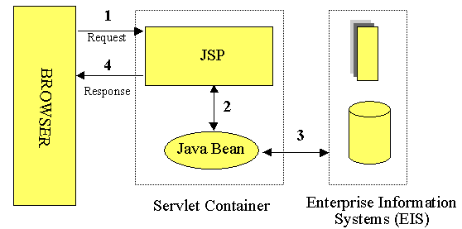
JSP Access Models

Slide 11
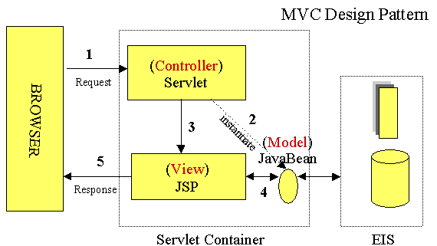
Model View Controller (MVC)

Slide 12
JSP Directive
JSP directives are messages for the JSP engine.
They do not directly produce any visible output, but tell the engine what to do with the rest of the JSP page.
JSP directives are always enclosed within the <%@ ... %> tag.
The two primary directives are page and include.
<%@ directive attribute="value" %>

Slide 13
Declarations
JSP declarations let you define page-level variables to save information or define supporting methods that the rest of a JSP page may need.
Declarations are found within the <%! ... %> tag.
<%! int i=0; %>
You can also declare methods.
<%!
public void jspInit( )
{ //some initialization code }
%>

Slide 14
Expressions
With expressions in JSP, the results of evaluating the expression are converted to a string and directly included within the output page.
Typically expressions are used to display simple values of variables or return values by invoking a bean's getter methods.
JSP expressions begin within <%= ... %> tags and do not include semicolons:
<%= someVariable %>
<%= someBean.getName() %>

Slide 15
Scriptlets
scriptlets are embedded within <% ... %> tags.
This Java code is run when the request is serviced by the JSP page.
You can have just about any valid Java code within a scriptlet, and is not limited to one line of source code.
<% for (int i=1; i<=4; i++) { %>
<H<%=i %>>Hello</H<%=i %>>
<% } %>

Slide 16
Comments
Although you can always include HTML comments in JSP pages, users can view these if they view the page's source.
If you don't want users to be able to see your comments, embed them within the
<%-- ... --%> tag:
<%-- comment for server side only --%>

Slide 17
Page Directive
The page directive lets you define one or more of the following case-sensitive attributes:
import="package.class" or import="package.class1,...,package.classN".
example:
<%@ page import="java.util.*" %>
The import attribute is the only one that is allowed to appear multiple times

Slide 18
Page Directive
contentType="MIME-Type"
<%@ page contentType="text/plain" %>
has the same effect as the scriptlet
<% response.setContentType("text/plain"); %>
isThreadSafe="true|false".
A value of false indicates that the servlet should implement SingleThreadModel

Slide 19
Page Directive
session="true|false". A value of true (the default) indicates that the predefined variable session (of type HttpSession) should be bound to the existing session if one exists, otherwise a new session should be created and bound to it.
A value of false indicates that no sessions will be used.

Slide 20
Page Directive
buffer="sizekb|none". This specifies the buffer size for the JspWriter out. The default is server-specific, but must be at least 8kb.
autoflush="true|false". A value of true, the default, indicates that the buffer should be flushed when it is full. A value of false, rarely used, indicates that an exception should be thrown when the buffer overflows. A value of false is illegal when also using buffer="none".
info="message". This defines a string that can be retrieved via the getServletInfo() method.

Slide 21
Page Directive
errorPage="url". This specifies a JSP page that should process any Throwables thrown but not caught in the current page.
isErrorPage="true|false". This indicates whether or not the current page can act as the error page for another JSP page. The default is false

Slide 22
Include Directive
This directive lets you include files at the time the JSP page is translated into a servlet.
<%@ include file="relative url" %>
<BODY>
<%@ include file="/navbar.html" %>
<!-- Part specific to this page ... -->
</BODY>

Slide 23
XML Format JSP
The XML syntax for defining directive is
<jsp:directive.directiveType attribute=value />
For example, the XML equivalent of
<%@ page import="java.util.*" %> is
<jsp:directive.page import="java.util.*" />

Slide 24
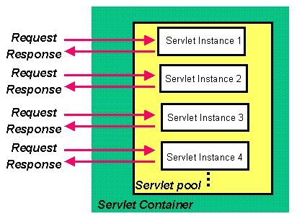
Multiple Instance in case of SingleThreadModel

Slide 25
Use Synchronized block
<% synchronized (application) {
SharedObject f = (SharedObject) application.getAttribute("sharedObject"); ……
application.setAttribute("sharedObject",f); }
%>

Slide 26
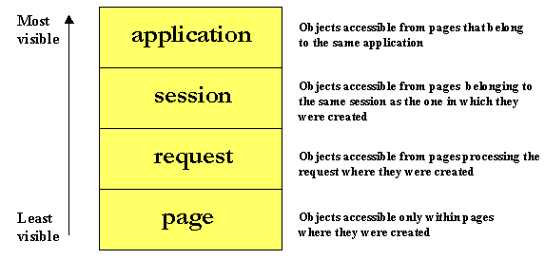
Object Scopes

Slide 27
Implicit Objects
request
response
out This is a buffered version of PrintWriter called JspWriter.
Session
application This is the ServletContext as obtained via getServletConfig().getContext().
page This is simply a synonym for this, and is not very useful in Java.

Slide 28
Standard Actions
Actions allow you to perform sophisticated tasks like instantiating objects and communicating with server-side resources like JSP pages and servlets without requiring Java coding.
Although the same can be achieved using Java code within scriptlets, using action tags promotes reusability of your components and enhances the maintainability of your application.

Slide 29
Standard Actions
jsp:include - Include a file at the time the page is requested.
jsp:useBean - Find or instantiate a JavaBean.
jsp:setProperty - Set the property of a JavaBean.
jsp:getProperty - Insert the property of a JavaBean into the output.
jsp:forward - Forward the requester to a new page

Slide 30
UseBean
The <jsp:useBean> tag tries to obtain a reference to an existing instance using the specified id and scope, as the bean may have been previously created and placed into the session or application scope from within a different JSP page.
The bean is newly instantiated using the Java class name specified through the class attribute only if a reference was not obtained from the specified scope
<jsp:useBean id="user" class="Person" scope="session" />

Slide 31
useBean
<jsp:useBean id="user" class="Person" scope="session">
<% user.setDate(DateFormat.getDateInstance( ).format(new Date())); //etc.. %>
</jsp:useBean>

Slide 32
Get and set properties
<jsp:getProperty name="user" property="name" />
<jsp:setProperty name="user" property="name" value=“Vijay" /> or
<jsp:setProperty name="user" property="name" value="<%=expression %>" />
<jsp:setProperty name="user" property="*"/>

Slide 33
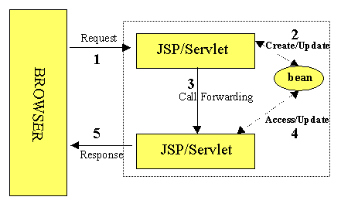
Forwarding Requests
<jsp:forward page="somePage.jsp" />

Slide 34
Forwarding Requests
A <jsp:forward> tag may also have jsp:param subelements that can provide values for some elements in the request used in the forwarding:
<jsp:forward page="<%= somePage %>" >
<jsp:param name="name1" value="value1" />
<jsp:param name="name2" value="value2" />
</jsp:forward>

Slide 35
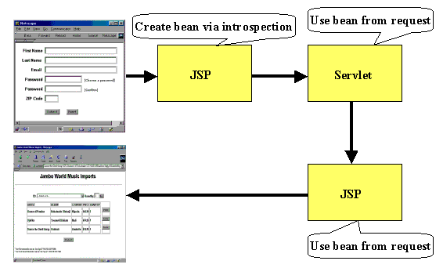

Slide 36
Forwarding beans
<jsp:useBean id="fBean" class="FormBean" scope="request"/> <jsp:setProperty name="fBean" property="*" />
<jsp:forward page="/servlet/JSP2Servlet" />
SERVLET:
public void doPost (HttpServletRequest request, HttpServletResponse response)
{ try {
FormBean f = (FormBean) request.getAttribute ("fBean"); f.setName("Mogambo");
// do whatever else necessary…

Slide 37
Forwarding Beans
getServletContext(). getRequestDispatcher("/jsp/Bean2.jsp"). forward(request, response);
}
catch (Exception ex) { . . . }
}
The JSP page Bean2.jsp
<jsp:useBean id="fBean" class="FormBean" scope="request"/> <jsp:getProperty name="fBean" property="name" />

Slide 38
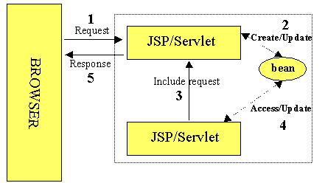
Including Requests

Slide 39
Including Requests
<jsp:include page="shoppingcart.jsp" flush="true"/>
not only allows shoppingcart.jsp to access any beans placed within the request using a <jsp:useBean> tag,
but the dynamic content produced by it is inserted into the calling page at the point where the <jsp:include> tag occurs.

Slide 40
Examples

Slide 41
<body bgcolor="white">
<h1> Request Information </h1>
<font size="4">
JSP Request Method: <%= request.getMethod() %> <br>
Request URI: <%= request.getRequestURI() %> <br>
Request Protocol: <%= request.getProtocol() %> <br>
Servlet path: <%= request.getServletPath() %> <br>
Query string: <%= request.getQueryString() %><br>
Content length:<%= request.getContentLength() %><br>
Content type: <%= request.getContentType() %><br>
Server name: <%= request.getServerName() %><br>
Server port: <%= request.getServerPort() %><br>
Remote user: <%= request.getRemoteUser() %><br>
Remote address: <%= request.getRemoteAddr() %><br>
Remote host: <%= request.getRemoteHost() %><hr>
The browser you are using is <%= request.getHeader("User-Agent") %>
<hr></font></body></html>

Slide 42
SimpleBean.java
Here's the source code for the bean used in the BeanTest JSP page.
package mypack;
public class SimpleBean {
String message = "No message specified";
public String getMessage() {
return(message);
}
public void setMessage(String message)
{ this.message = message; }
}

Slide 43
BeanTest.jsp
<HTML>
<BODY>
<jsp:useBean id="test" class=“mypack.SimpleBean" />
<jsp:setProperty name="test" property="message" value="Hello WWW" />
Message: <jsp:getProperty name="test“ property="message" />
<BODY>
</HTML>

Slide 44
package pc;
public class StrBean
{
String word;
public String reverse()
{
return (new StringBuffer(word).reverse()).toString();
}
public String getWord()
{
return word;
}
public void setWord(String w)
{
word = w;
}
}

Slide 45
html
<form action="wordpro.jsp" method="post">
Enter Word:
<input type ="text" name="word">
<select name="mode">
<option value="1" selected> Reverse </option>
<option value="2" > Straight </option>
</select><br>
<input type=submit>

Slide 46
JSP
<jsp:useBean id="str" scope="request" class=“pc.StrBean" />
<jsp:setProperty name="str" property="*" />
You entered <%= request.getParameter("word") %> <br>
Output is :<br>
<%
if(Integer.parseInt(request.getParameter("mode"))==1)
out.print(str.reverse());
else
{
%>
<jsp:getProperty name="str" property="word" />
<%
}
%>

Slide 47
JSP Sessions
GetName.html
<FORM METHOD=POST ACTION="SaveName.jsp">
name? <INPUT TYPE=TEXT NAME=username SIZE=20><P>
<INPUT TYPE=SUBMIT></FORM>
SaveName.jsp
<%
String name = request.getParameter( "username" );
session.setAttribute( "theName", name );%>
<BODY>
<A HREF="NextPage.jsp">Continue</A></BODY>

Slide 48
NextPage.jsp shows how to retrieve the saved name.
<HTML>
<BODY>
Hello, <%= session.getAttribute( "theName" ) %>
</BODY></HTML>

Slide 49
Beans and Session
GetName.html
<FORM METHOD=POST ACTION="SaveName.jsp">
Name? <INPUT TYPE=TEXT NAME=username SIZE=20><BR>
E-mail? <INPUT TYPE=TEXT NAME=email SIZE=20><BR>
Age? <INPUT TYPE=TEXT NAME=age SIZE=4><P>
<INPUT TYPE=SUBMIT>
</FORM>

Slide 50
"SaveName.jsp"
<jsp:useBean id="user" class=“pck.UserData" scope="session"/>
<jsp:setProperty name="user" property="*"/>
<A HREF="NextPage.jsp">Continue</A>

Slide 51
package pck;
public class UserData {
String username;
String email;
int age;
public void setUsername( String value ) { username = value; }
public void setEmail( String value ) { email = value; }
public void setAge( int value ) { age = value; }
public String getUsername() { return username; }
public String getEmail() { return email; }
public int getAge() { return age; }
}

Slide 52
NextPage.jsp
<jsp:useBean id="user" class=“pck.UserData" scope="session"/>
You entered <BR>Name: <%= user.getUsername() %><BR>
Email: <%= user.getEmail() %><BR>
Age: <%= user.getAge() %><BR>

Slide 53
MORE EXAMPLES ON SESSION TRACKING

Slide 54
Carts.html
<body>
<FORM TYPE=POST ACTION=carts.jsp> <BR>
Please enter item to add or remove: <br>
Add Item:
<SELECT NAME="item">
<OPTION>TERMINATOR
<OPTION>X-files
<OPTION>BABE
<OPTION>CASPER
</SELECT>
<br> <br>
<INPUT TYPE=submit name="submit" value="add">
<INPUT TYPE=submit name="submit" value="remove">
</form>
</body>

Slide 55
Carts.jsp
<jsp:useBean id="cart" scope="session" class=“ca.DummyCart" />
<jsp:setProperty name="cart" property="*" />
<%
cart.processRequest(request);
%>
<br> You have the following items in your cart:
<ol>
<%
String[] items = cart.getItems();
for (int i=0; i<items.length; i++) {
%>
<li> <%= items[i] %>
<% } %>
</ol>
<hr>
<%@ include file ="carts.html" %>
</html>

Slide 56
DummyCart.java
package ca;
import javax.servlet.http.*;
import java.util.Vector;
import java.util.Enumeration;
public class DummyCart {
Vector v = new Vector();
String submit = null;
String item = null;
private void addItem(String name) {
v.addElement(name);
}
private void removeItem(String name) {
v.removeElement(name);
}

Slide 57
public void setItem(String name) {
item = name;
}
public void setSubmit(String s) {
submit = s;
}
public String[] getItems() {
String[] s = new String[v.size()];
v.copyInto(s);
return s;
}
public void processRequest(HttpServletRequest request) {
if (submit.equals("add"))
addItem(item);
else if (submit.equals("remove"))
removeItem(item);
}
}

Slide 58
Login.html
<form method="get" action="login.jsp">
Name:<input type=text size=25 name="uname">
<input type = submit>
</form>
Login.jsp
<% String s = request.getParameter("uname");
session.setAttribute("username",s);
%>
Dear <%= s %>, welcome to shop.
<a href="http://localhost:1026/sale/shome.jsp">
Go to Shopping Page </a>
<%
Vector v = new Vector();
session.setAttribute("Shopping_List",v);
%>

Slide 59
Shome.jsp
<%@ page import="java.util.*" %>
<%@ page language = "java" %>
<form method=get action="shopping_cart.jsp">
<INPUT TYPE = submit name="VISUAL BASIC" VALUE="VISUAL BASIC">
<INPUT TYPE = submit name="VISUAL C++" VALUE="VISUAL C++">
<INPUT TYPE = submit name="VISUAL J++" VALUE="VISUAL J++">
</FORM>

Slide 60
Shopping_cart.jsp
<form method="get" action="update_wishlist.jsp">
<p>Dear <%= session.getAttribute("username")%></p>
<p>Your shopping cart contains following items:</font></p>
<%@ page import="java.util.*" %>
<%@ page language = "java" %>
<%! Vector vector=new Vector(1,1);%>
<%
try{
Enumeration paramNames = request.getParameterNames();
Vector existingVector=(Vector)session.getAttribute("Shopping_List");

Slide 61
while(paramNames.hasMoreElements())
{
String paramName = (String)paramNames.nextElement();
String str=request.getParameter(paramName);
existingVector.addElement((String)paramName);
}
session.setAttribute("Shopping_List", existingVector);
}
catch(Exception e){ }
%>

Slide 62
<%
Vector shoppingVectors=(Vector)session.getAttribute("Shopping_List");
int ctr=shoppingVectors.capacity();
int i=0;
try{
for(;i<ctr;i++)
{
String str=shoppingVectors.elementAt(i).toString();
out.println("<br>"+str);
}
}
catch(Exception e){ } %>
</form>
<a href="shome.jsp"> Back to Shop </a>

Slide 63
Error Page Calc.html
<h1>Calculator</h1>
<form method="POST" action="output.jsp">
<table border="1">
<tr><th>Operand 1</th>
<td><input type="text" size="10" name ="v1" ></td>
</tr>
<tr> <th> Operation </th>
<td><input type="radio" checked name="operation“ value="add">Add </td>
<td><input type="radio" name="operation" value="sub">Sub</td>
<td><input type="radio" name="operation" value="mul">Mul</td>
</tr>
<tr> <th>Operand 2</th>
<td><input type="text" size="10" name ="v2" ></td>
</tr>
<tr><td colspan="2"><input type="submit" value = "Submit"></td>
</tr></table>

Slide 64
Calculator Bean
package cal;
public class Calculator
{
String v1,v2,operation;
public void setV1(String op1)
{ v1 =op1; }
public String getV1()
{ return v1; }
public void setV2(String op2)
{ v2 =op2; }
public String getV2()
{ return v2; }
public void setOperation(String op)
{ operation = op; }

Slide 65
public String getOperation()
{ return operation; }
public String getSolution()
{
int iop1 =0;
iop1 = Integer.parseInt(v1);
int iop2=0;
iop2 = Integer.parseInt(v2);
int sol=0;
if(operation.equals("add"))
{ sol=iop1+iop2;
}
else if(operation.equals("sub"))
{ sol = iop1-iop2;
}
return String.valueOf(sol);
}}

Slide 66
output.jsp
<%@ page errorPage="error.jsp" %>
<jsp:useBean id="calc" scope="page" class=“cal.Calculator" />
<jsp:setProperty name="calc" property="*" />
<table border="1">
<tr>
<th>Operand 1</th>
<td><jsp:getProperty name ="calc" property="v1" /> </td>
</tr>
<tr>
<th>Operand 2</th>
<td><jsp:getProperty name ="calc" property="v2" /> </td>
</tr>
<tr>
<th>Operation </th>
<td><jsp:getProperty name ="calc" property="operation" /> </td>
</tr>
<tr>

Slide 67
<th>Result</th>
<td><jsp:getProperty name ="calc" property="solution" /> </td>
</tr>
<p>
<a href="calc.html"> Restart </a>

Slide 68
error.jsp
<%@ page import="java.util.*" isErrorPage="true" %>
<title>Error Page </title>
<h1> Error </h1>
<table border="1">
<%Enumeration e = request.getParameterNames();
while(e.hasMoreElements())
{
String name = ( String)e.nextElement();
%>
<tr>
<th> <%= name %> </th>
<td><%= request.getParameter(name) %> </td>
</tr>
<%
}
%></table>
<p><a href="Calc.html"> Restart </a>

